Slide 1

Digital Image Processing
Chapter4: Spatial Filters
Dr. Mohammad Javad Parseh
Jahrom University
Department of Computer Engineering and Information Technology
October 2024

Slide 2
Introduction
In this chapter, we begin our journey of learning image processing. The first concept we will master is filtering, which is at the heart of image quality and further processing.
In image processing, a filter removes undesirable impurities which includes noise. In some cases, the impurities might be visually distracting and in some cases might produce error in further processing.
Some filters are also used to suppress certain features in an image and highlight others. For example, the first derivative and second derivative filters that we will discuss are used to determine or enhance edges in an image.

Slide 3
Introduction (cont.)
There are two types of filters: linear filters and non-linear filters.
Linear filters include mean, Laplacian and Laplacian of Gaussian. Non-linear filters include median, maximum, minimum, Sobel, Prewitt and Canny filters.
Image enhancement can be accomplished in two domains: spatial and frequency.
The spatial domain constitutes all the pixels in an image. The domain over which the Fourier transformation of an image ranges is known as the frequency domain of the image.

Slide 4
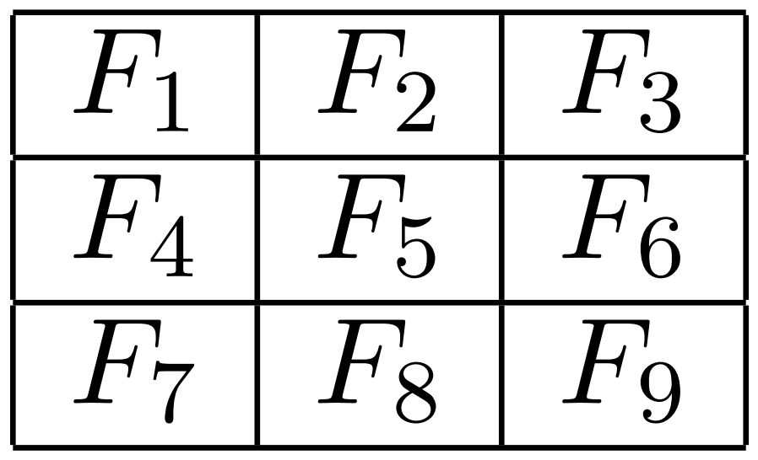
Filtering
An image processing filter removes undesired features (such as noise) from an image. Each filter has a specific utility and is designed to either remove a type of noise or to enhance certain aspects of the image.
For filtering, a filter or mask is used. It is usually a two-dimensional square window that moves across the image affecting only one pixel at a time.
Each number in the filter is known as a coefficient. Let us consider a 3-by-3 filter:

Slide 5
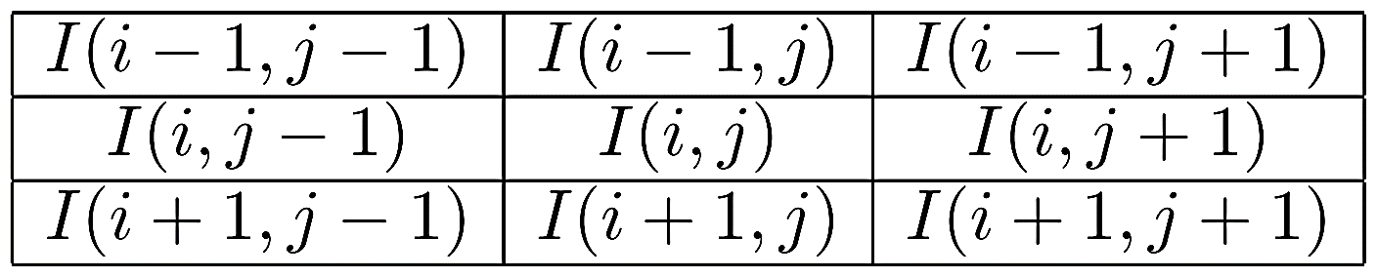
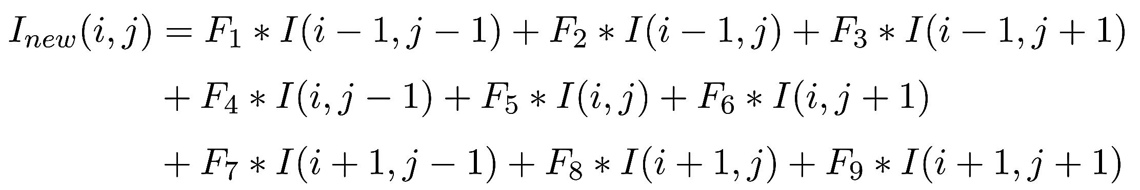
Filtering (cont.)
If (i,j) is the pixel in the image, then a sub-image around (i,j)of the same dimension as the filter is considered for filtering.
where I_{new}(i,j) is the output value at location (i,j).

Slide 6
Padding
The convolution operation has to be performed at every pixel in the image including pixels at the boundary of the image.
The padded pixels can be assumed to be either zero or a constant value. Other padding options such as nearest neighbor or reflect create padded pixels using pixel values in the image.
Let us consider an example to show different padding options. Following figure is a 7-by-7 input image to be convolved using a 3-by-5 filter with the center of the filter at (1,2).

Slide 7
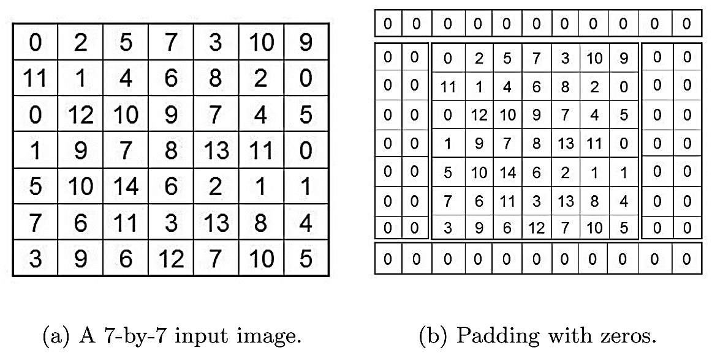
Padding (cont.)

Slide 8
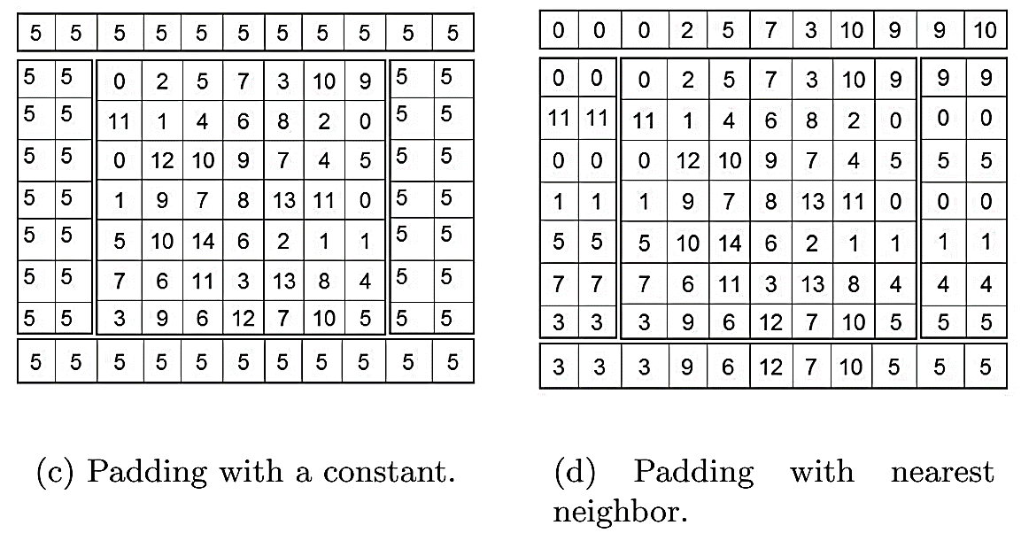
Padding (cont.)

Slide 9
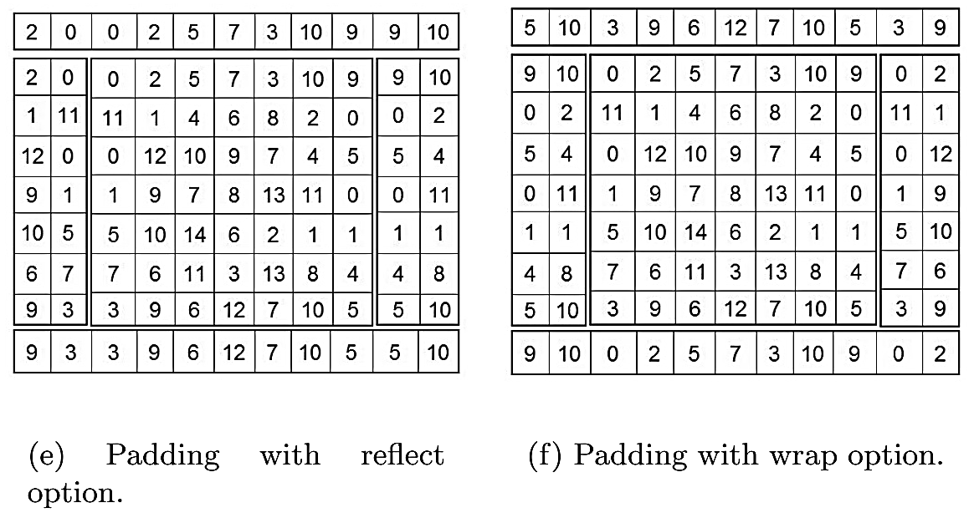
Padding (cont.)

Slide 10
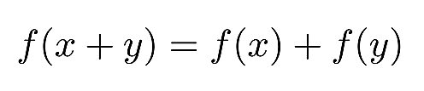
Mean Filter
In mathematics, functions are classified into two groups, linear and non-linear. A function f is said to be linear if:
Otherwise, f is non-linear. An excellent example of a linear filter is the mean filter.
Unlike other filters discussed in this chapter, the mean filter does not have a scipy.ndimage module function. However, we can use the convolve function to achieve the intended result.

Slide 11
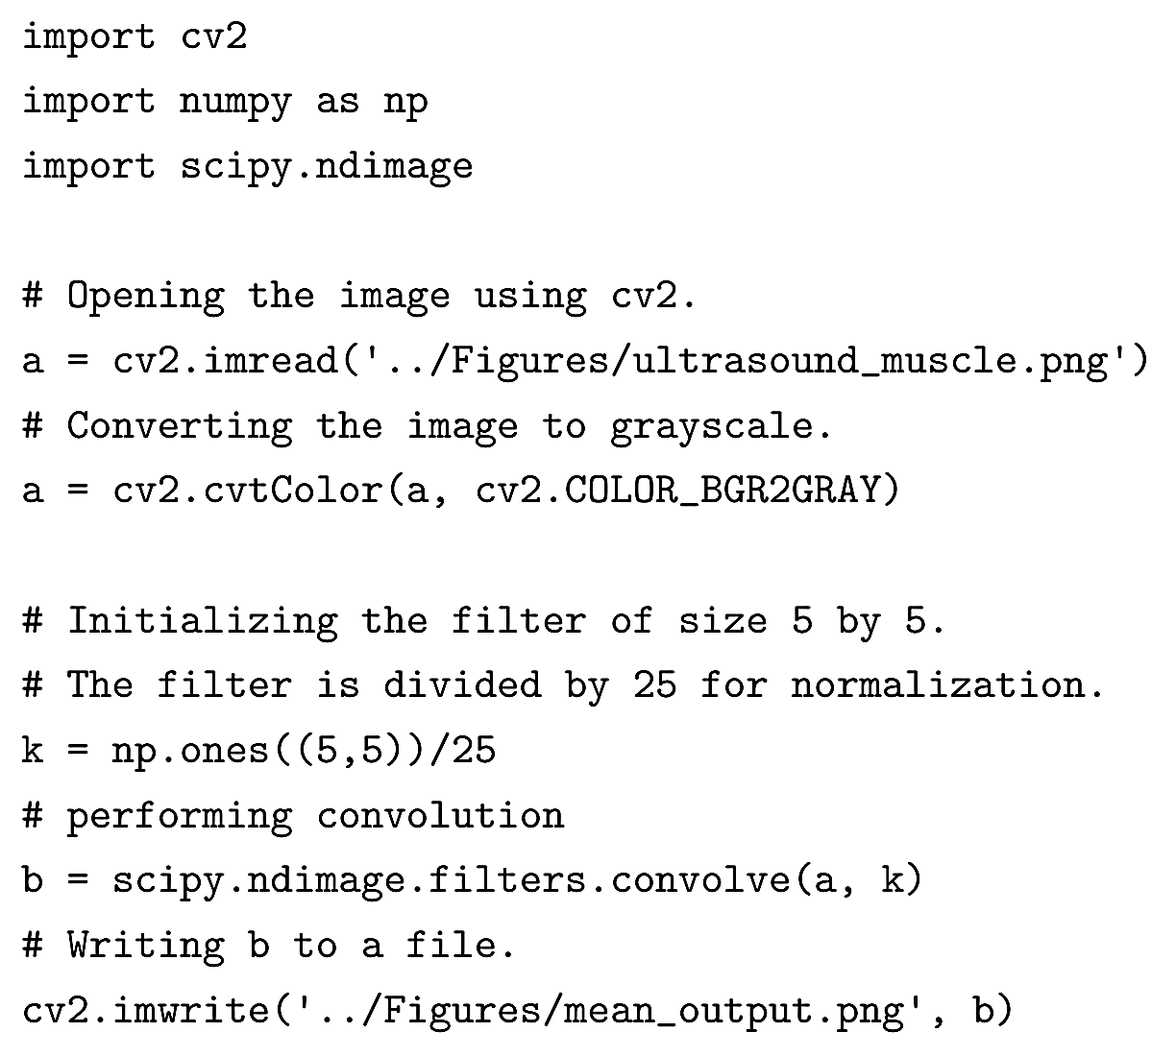
Mean Filter (cont.)

Slide 12
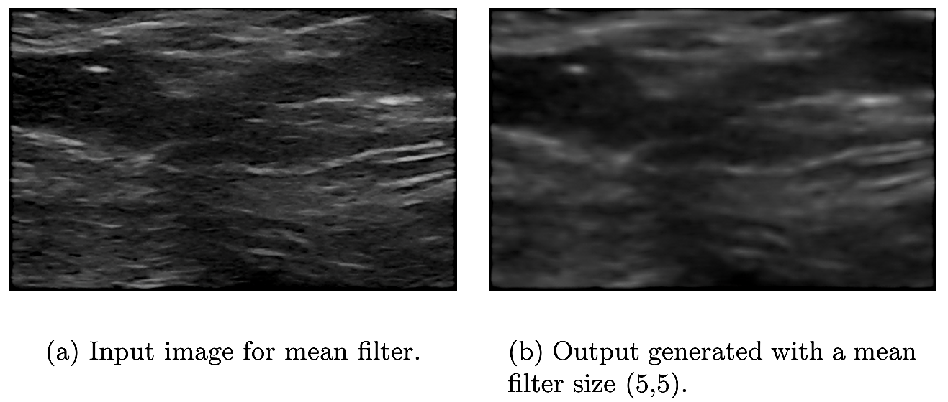
Mean Filter (cont.)

Slide 13
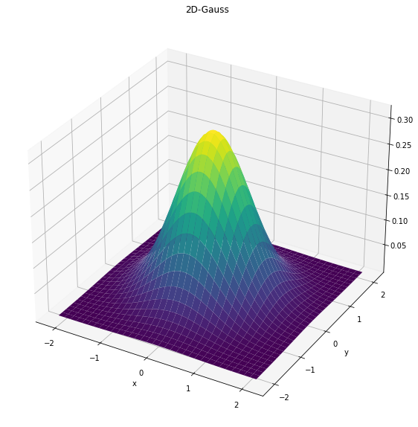
Gaussian Filter

Slide 14
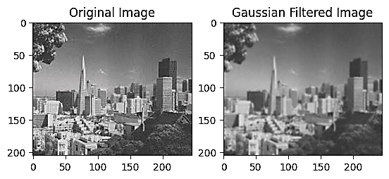
Gaussian Filter (cont.)

Slide 15
Median Filter
The median filter is one of the most popular non-linear filters.
A sliding window is chosen and is placed on the image at the pixel position (i,j). All pixel values under the filter are collected. The median of these values is computed and is assigned to (i,j)in the filtered image.
The median filter is most commonly used in removing salt-and-pepper noise and impulse noise. Salt-and-pepper noise is characterized by black and white spots randomly distributed in an image.

Slide 16
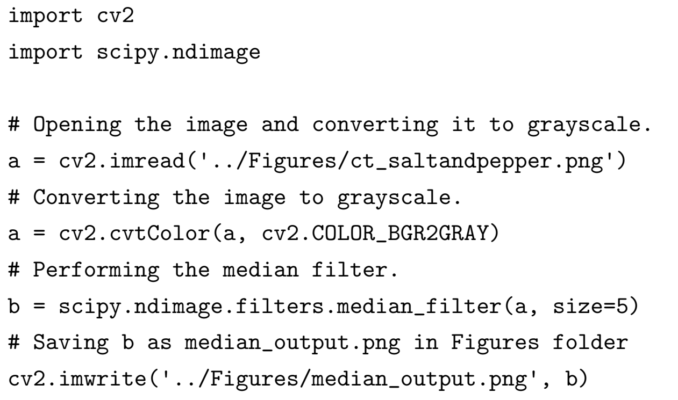
Median Filter (cont.)

Slide 17
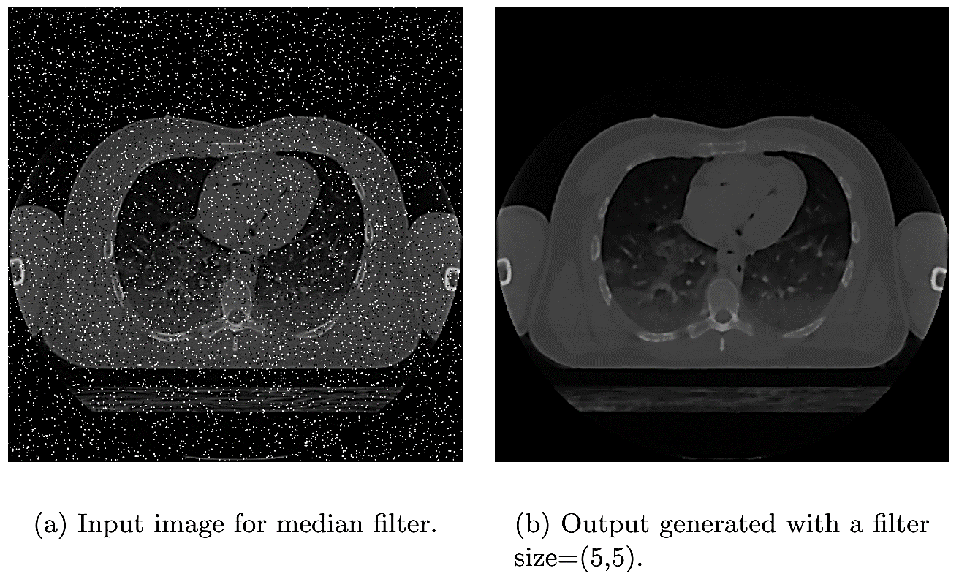
Median Filter (cont.)

Slide 18
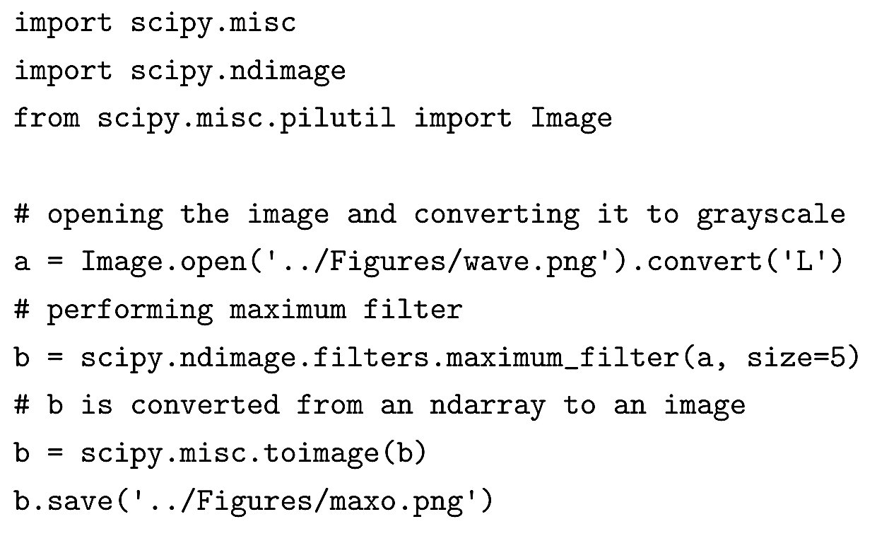
Max Filter
This filter enhances the bright points in an image. In this filter the maximum value in the sub-image replaces the value at (i,j).

Slide 19
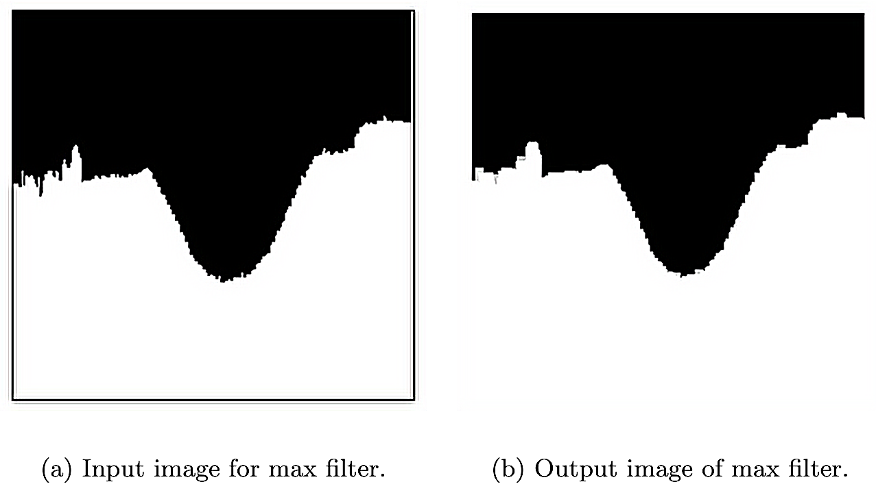
Max Filter (cont.)

Slide 20
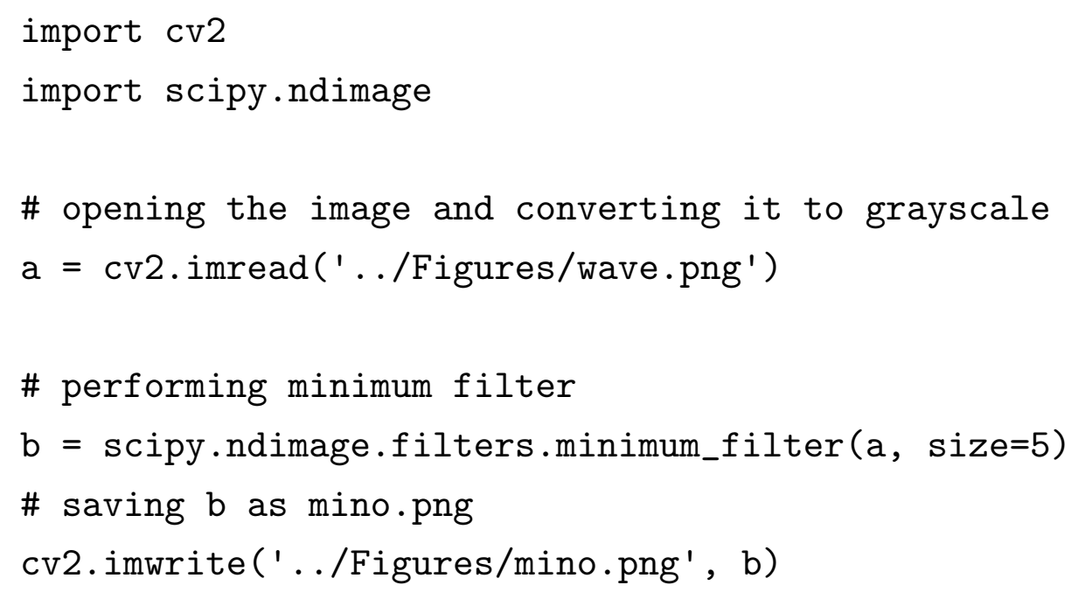
Min Filter
This filter is used to enhance the darkest points in an image. In this filter, the minimum value of the sub-image replaces the value at (i,j).

Slide 21
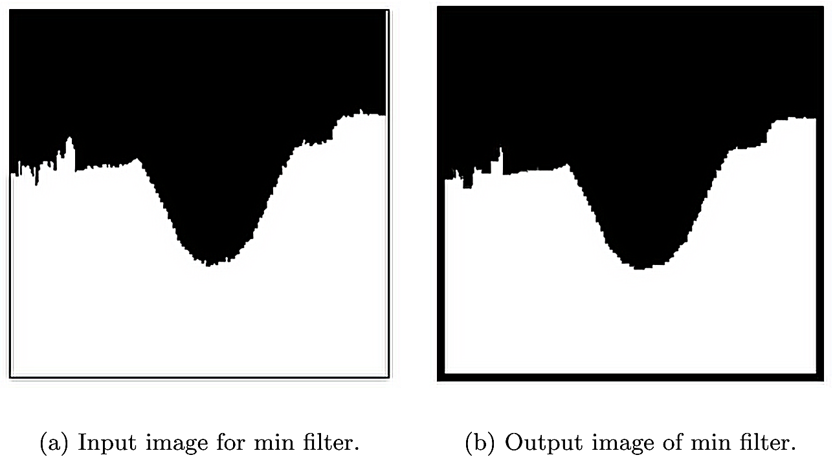
Min Filter (cont.)

Slide 22
Edge Detection using Derivatives
Edges are a set of points in an image where there is a change of intensity between one side of that point and the other.
From calculus, we know that the changes in intensity can be measured by using the first or second derivative.
Notice that at the point of transition from dark region to light region, there is a change in intensity in the profile.

Slide 23
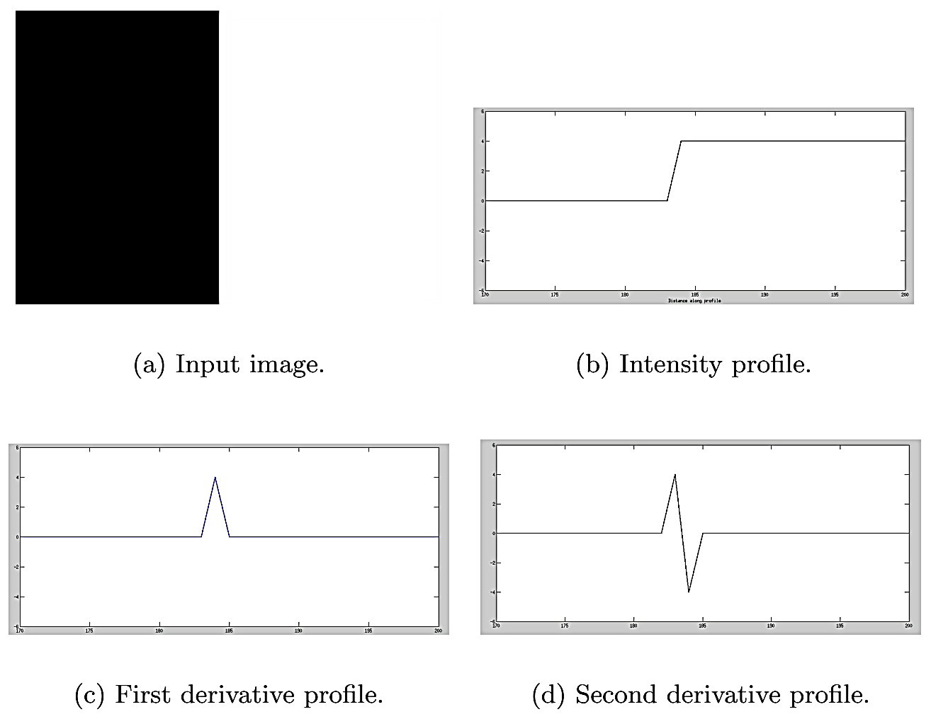
Edge Detection using Derivatives (cont.)

Slide 24
Edge Detection using Derivatives (cont.)
In the transition region, since the intensity profile is increasing, the first derivative is positive, while being zero in the dark and light regions.
The first derivative has a maximum or peak at the edge.
Since the first derivative is increasing before the edge, the second derivative is positive before the edge. Likewise, since the first derivative is decreasing after the edge, the second derivative is negative after the edge.
At the edge, the second derivative is zero.

Slide 25
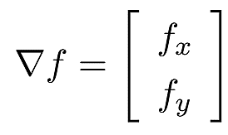
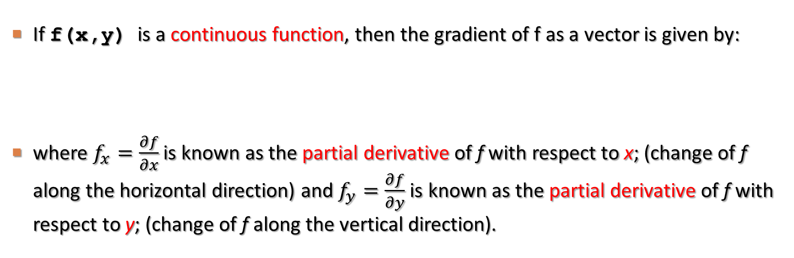
Edge Detection using Derivatives (cont.)
If f(x,y) is a continuous function, then the gradient of f as a vector is given by:
where $f_{x}=\frac{∂f}{∂x}$ is known as the partial derivative of f with respect to x; (change of f along the horizontal direction) and $f_{y}=\frac{∂f}{∂y}$ is known as the partial derivative of f with respect to y; (change of f along the vertical direction).

Slide 26
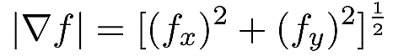
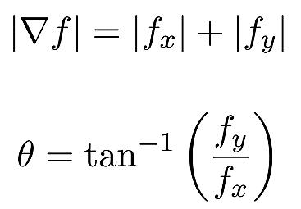
Edge Detection using Derivatives (cont.)
The magnitude of the gradient is a scalar quantity and is given by:
For computational purposes, we will use the simplified version of the gradient given by:

Slide 27
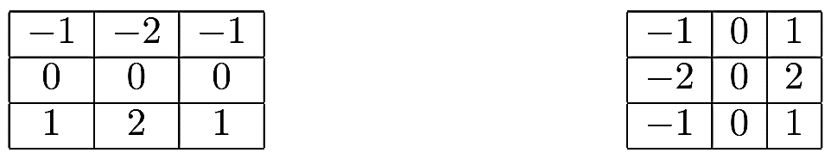
Sobel Filter
One of the most popular first derivative filters is the Sobel filter. The Sobel filter or mask is used to find horizontal and vertical edges as follows:

Slide 28
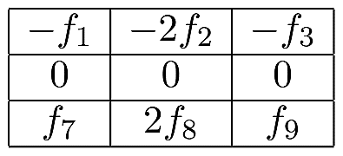
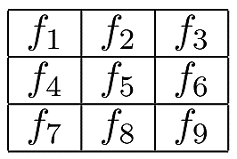
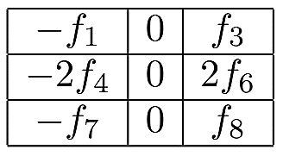
Sobel Filter (cont.)

Slide 29
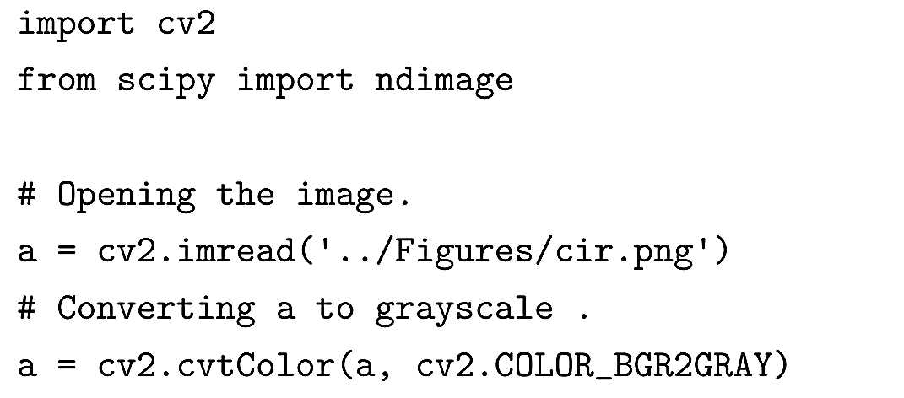
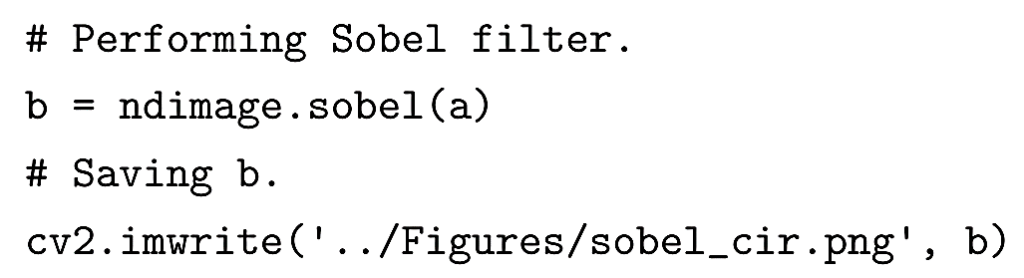
Sobel Filter (cont.)

Slide 30
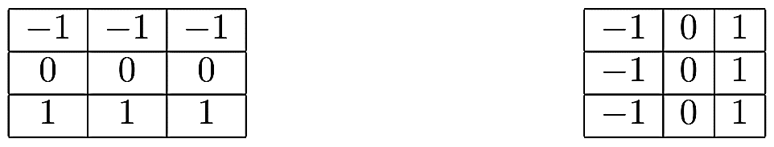
Prewitt Filter
Another popular first derivative filter is Prewitt. The masks for the Prewitt filter are as follows:
As in the case of the Sobel filter, the sum of the coefficients in Prewitt is also 0. Hence this filter does not affect pixels with constant grayscale. However, the filter does not reduce noise like the Sobel filter.

Slide 31
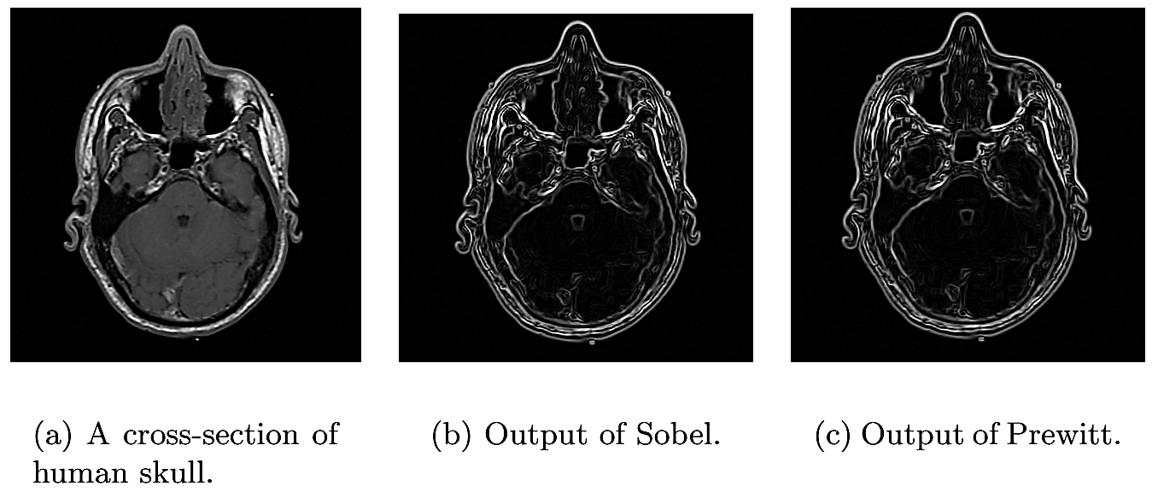
Prewitt Filter (cont.)

Slide 32
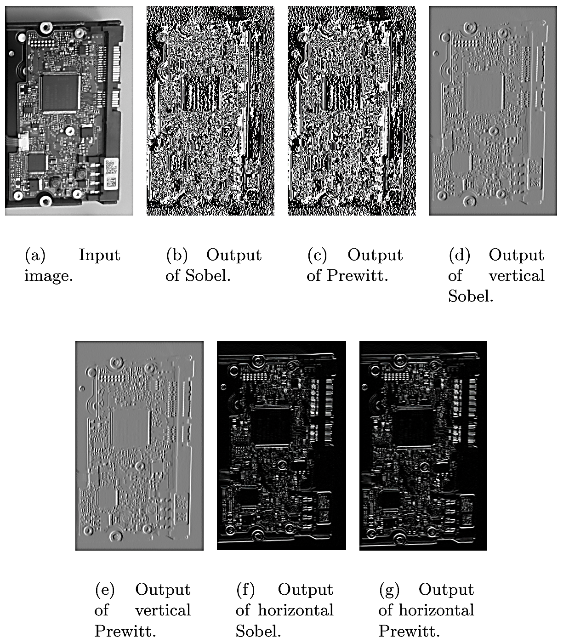
Sobel vs. Prewitt

Slide 33
Canny Filter
This filter uses three parameters to detect edges. The first parameter is the standard deviation, σ; for the Gaussian filter. The second and third parameters are the threshold values, t1 and t2. The Canny filter can be best described by the following steps:
A Gaussian filter is used on the image for smoothing.
For each pixel, the magnitude of the gradient and the corresponding direction are computed.
To identify edge points and suppress others, only maximum points (ridge points) are retained and other pixels are assigned a value of zero. This process is known as non-maximal suppression (NMS).
Ridge pixels with values greater than the high threshold are classified as strong edge pixels, whereas the ridge pixels between low threshold and high threshold are called weak edge pixels.
In the last step, the weak edge pixels are 8-connected with strong edge pixels.

Slide 34
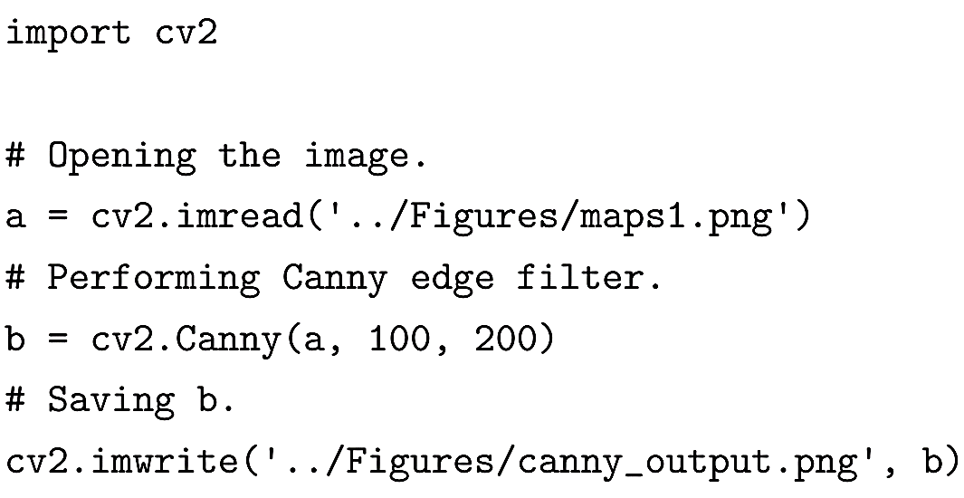
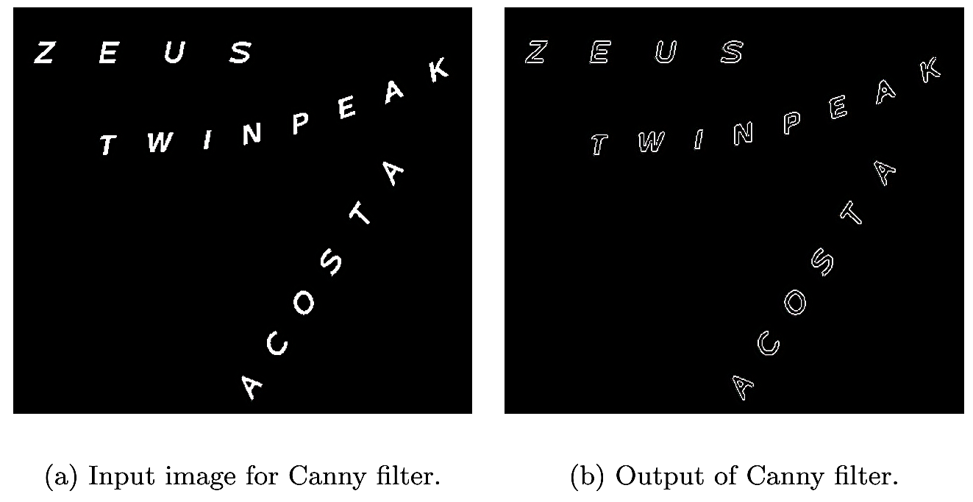
Canny Filter (cont.)

Slide 35
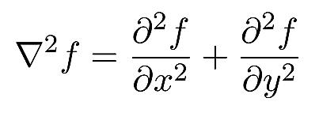
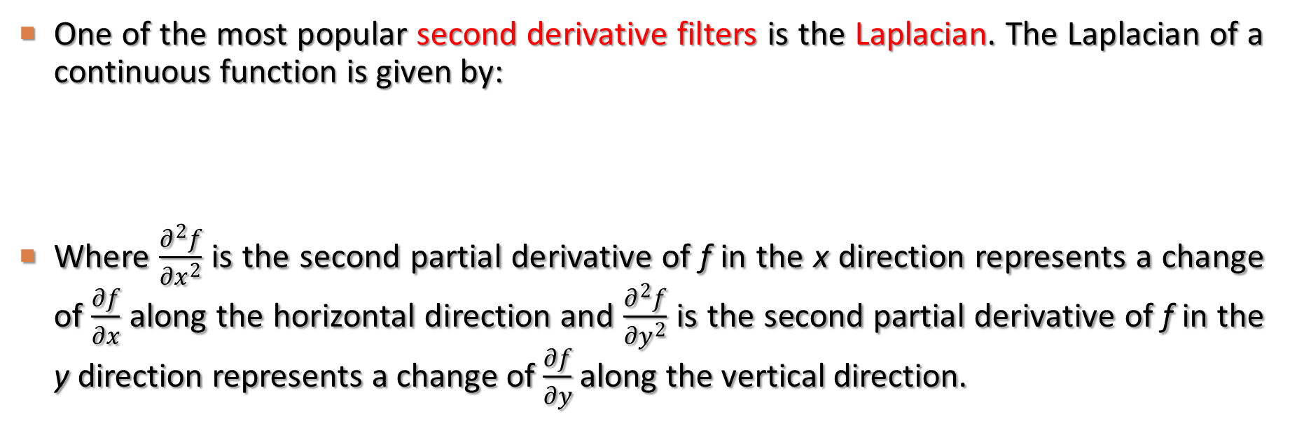
Laplacian Filter
One of the most popular second derivative filters is the Laplacian. The Laplacian of a continuous function is given by:
Where $\frac{∂^{2}f}{∂x^{2}}$ is the second partial derivative of f in the x direction represents a change of $\frac{∂f}{∂x}$ along the horizontal direction and $\frac{∂^{2}f}{∂y^{2}}$ is the second partial derivative of f in the y direction represents a change of $\frac{∂f}{∂y}$ along the vertical direction.

Slide 36
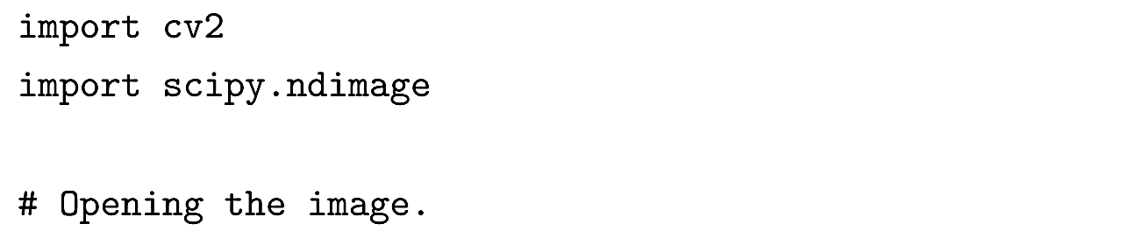
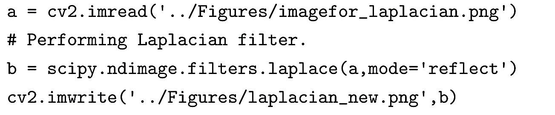
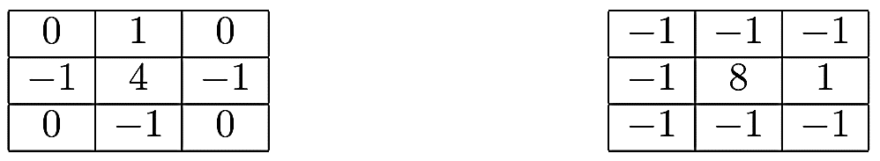
Laplacian Filter (cont.)
Most widely used Laplacian masks

Slide 37
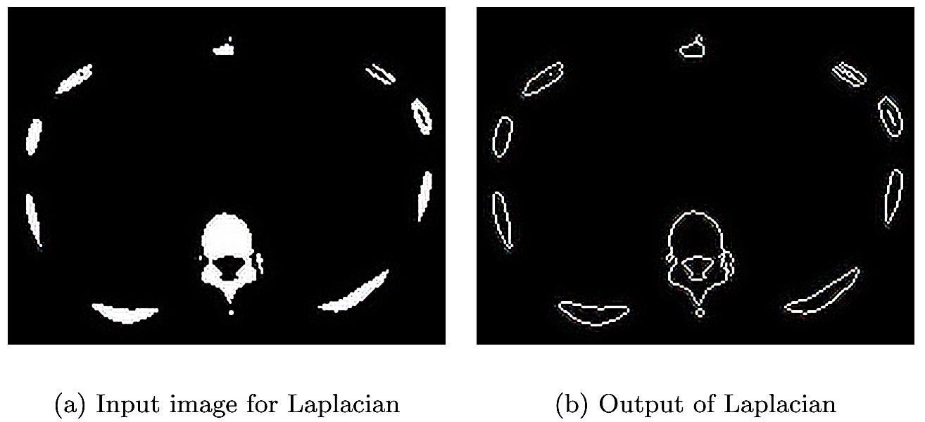
Laplacian Filter (cont.)

Slide 38
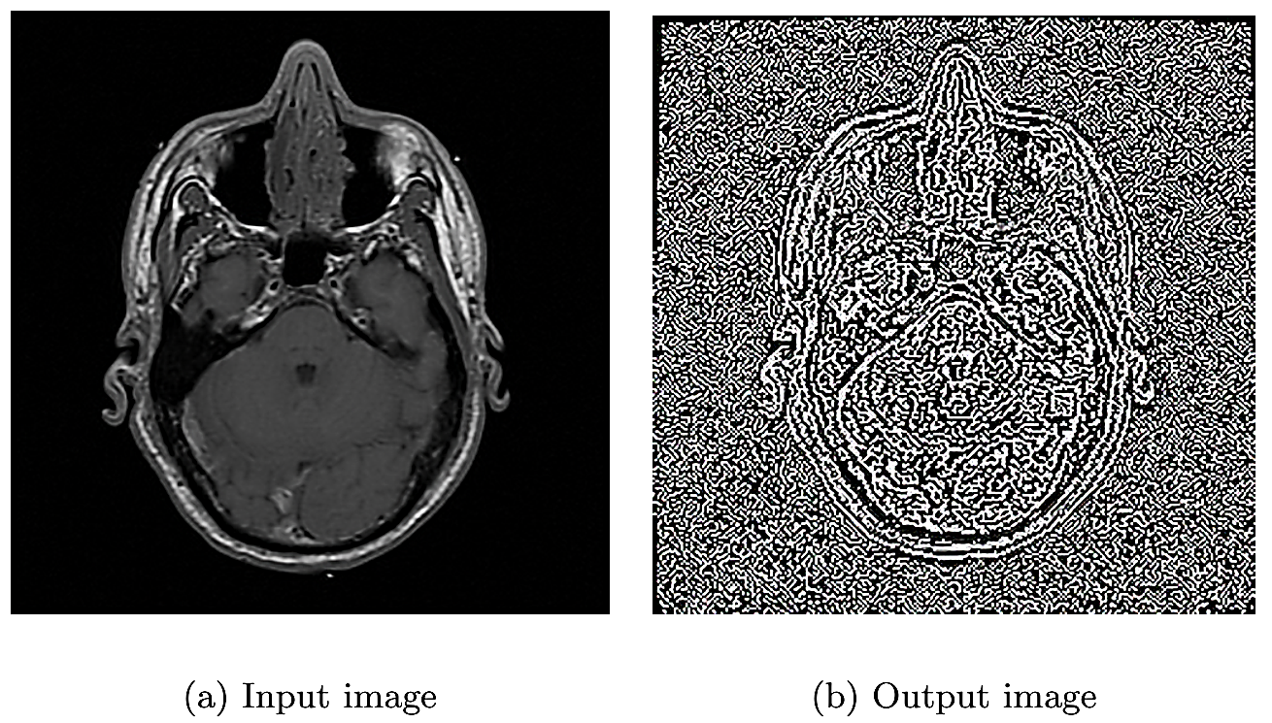
Noise in Derivative
A derivative filter adds noise to an image. The effect is magnified when the first derivative image is differentiated again (to obtain a second derivative) as in the case of second derivative filters.

Slide 39
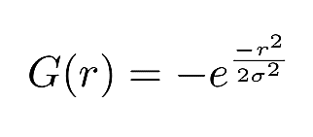
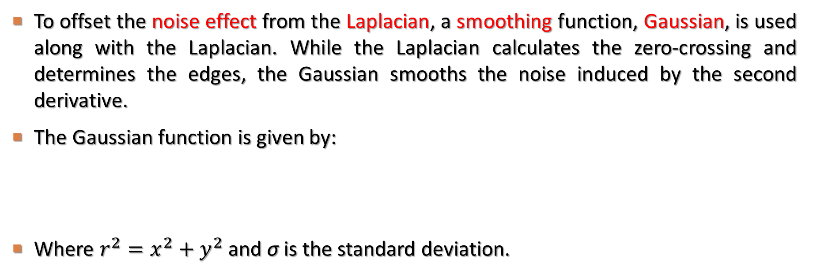
Laplacian of Gaussian Filter
To offset the noise effect from the Laplacian, a smoothing function, Gaussian, is used along with the Laplacian. While the Laplacian calculates the zero-crossing and determines the edges, the Gaussian smooths the noise induced by the second derivative.
The Gaussian function is given by:
Where $r^{2}=x^{2}+y^{2}$ and σ is the standard deviation.

Slide 40
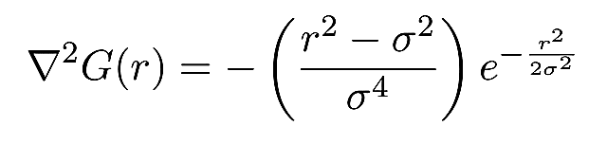
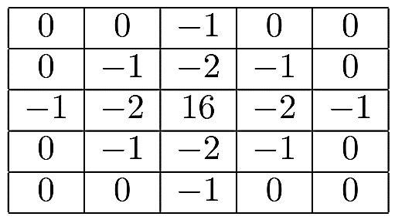
Laplacian of Gaussian Filter (cont.)
The Laplacian convolved with Gaussian is known as the Laplacian of Gaussian and is denoted by LoG. Since the Laplacian is the second derivative, the LoG expression can be obtained by finding the second derivative of G with respect to r; which yields:
The LoG mask or filter of size 5-by-5 is:

Slide 41
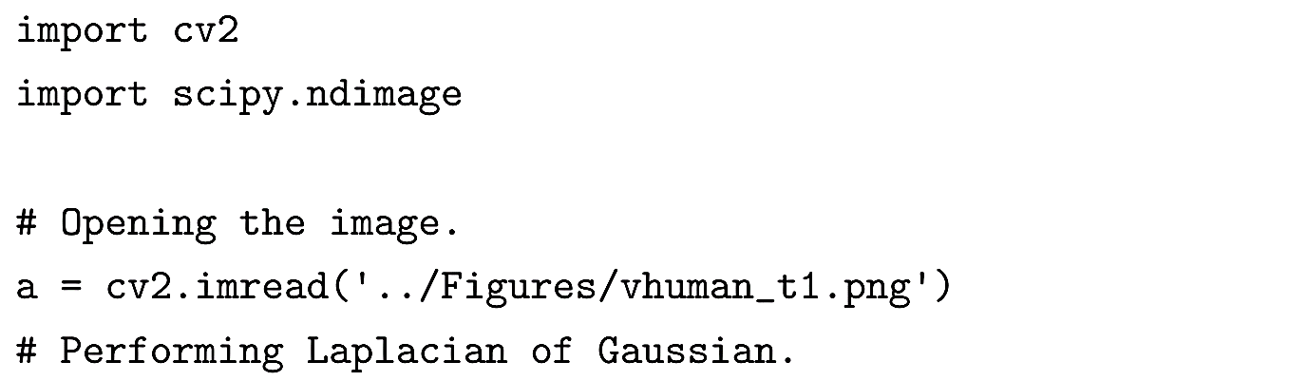
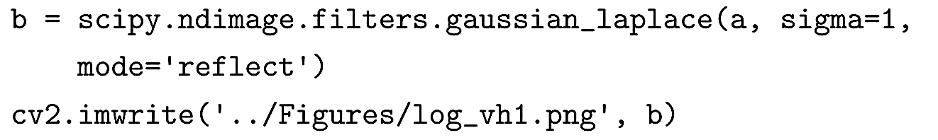
Laplacian of Gaussian Filter (cont.)
The major disadvantage of LoG is the computational price as two operations, Gaussian followed by Laplacian, have to be performed.
Even though LoG segments the object from the background, it over segments the edges within the object causing closed loops (also called the spaghetti effect).

Slide 42
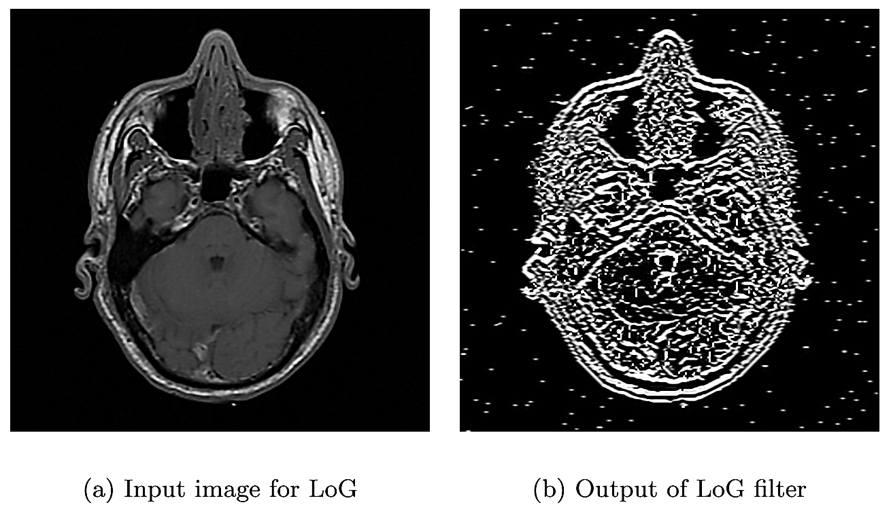
Laplacian of Gaussian Filter (cont.)

Slide 43
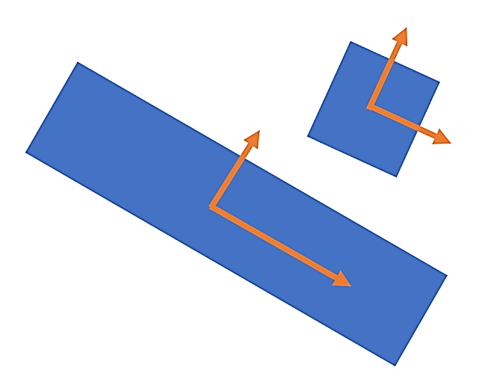
Shape Detecting Filter
The Frangi filter is used to detect vessel-like objects in an image.
The orthogonal arrows are drawn to be proportional to the length along a given direction. This qualitative geometrical difference can be quantified by finding the eigen values for these two objects.
The Frangi filter computes the eigen value on the second derivative (Hessian) image instead of computing the eigen value on the original image.

Slide 44
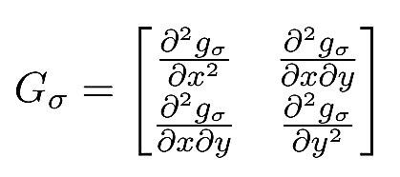
Frangi filter
To reduce noise due to derivatives, the image is smoothed by convolution. Generally, Gaussian smoothing is used.
We will determine the second derivative of Gaussian using the formula below where g_{σ} is a Gaussian:
For a 2D image, there will be two eigen values (λ₁ and λ₂) for each pixel coordinate. A pixel is considered to be part of a tubular or vessel-like structure if λ₁ ≈ 0 while | λ₂ |>| λ₁ |.

Slide 45
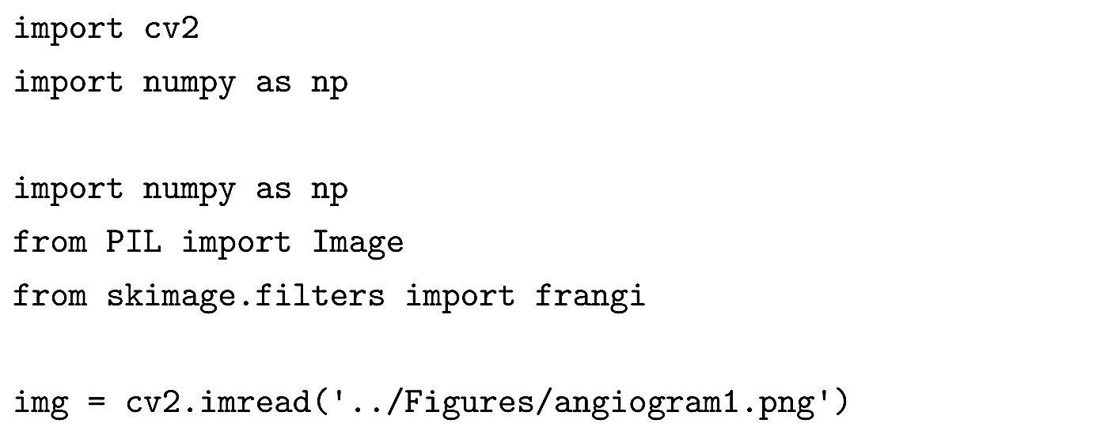

Frangi filter (cont.)

Slide 46

Frangi filter (cont.)

